Slide 1



Corridor1rep@opp2d.org
Corridor1rep@gmail.com
443-904-9070
WINTER COUNCIL meeting FEB 6, 2021
Bro. Dwayne R. Adams
Corridor I Representative
1st Vice Corridor I Rep – Bro. Anjuan Collins
2nd vice corridor I rep - bro. Azagio herd
Corridor I keeper of records and seal – bro. Micheal Parham, jr.
Corridor I keeper of finance - bro. Brian Wilson
Corridor I area I rep – bro. Richard Allison
Corridor I area ii rep – bro. Jon singleton
Corridor I area iii rep – bro. Marlon Robinson
Corridor I area iv rep – bro. Torrance beck
Maryland | Delaware | Pennsylvania |New Jersey |New York

Slide 2


agenda
Updates Since Fall Council Meeting
Upcoming Events
Budget
Questions
Appendix

Slide 3
Updates Since Fall Council Meeting
CORRIDOR I CHAPTER ACCOMPLISHMENTS
Supplemental educational programs for high school students conducted by chapters
Planned hosting of a televised program focused on community uplift
Chapters planned and executed several food drives and donation throughout Corridor I
Donations (clothing, blankets, household supplies, toothbrushes, desks/chairs) by chapters
Chapters assisted families in need during the holidays throughout Corridor I
Events honoring Dr. Martin Luther King, Jr were done by chapters
Chapters also planned and hosted Health Initiatives
Clothing and coat drives hosted by chapters in support of those in need in Corridor I

Slide 4
Updates Since Fall Council Meeting
CORRIDOR I CHAPTER ACCOMPLISHMENTS
Installation and swearing in of new chapter officers throughout the Corridor
Chapters hosted several events to promote voter registration and political action
Chapters conducted Achievement Week activities through virtual environment
Chapters hosted holiday toy drives and donations throughout Corridor I
Conducted MSP Information Sessions 1/22/21
Chapters maintained focus on mentorship through virtual environments

Slide 5
Upcoming Events
CORRIDOR I UPCOMING EVENTS
Corridor I Dr. Charles Drew Blood Drive Points of Contact: Bro. Dwayne White and Bro. John Berkley
Corridor I National Kidney Walk Point of Contact: Bro. John Berkley
Update of Corridor I Website (www.2dcorridor1.org), content to include:
Covid-19 Food Relief and Community Service spotlight on Iota Nu & Alpha Delta Gamma Chapters
Spotlight on Tau Pi Chapter highlighting their notable impact of donating $1,000 to the Bright Minds Foundation and Howard County Public Schools to assist with providing key essential items to African American students in grades K-8.

Slide 6
Upcoming Events
CORRIDOR I UPCOMING EVENTS
Update of website content continued:
Spotlight on Bro. Cameron "Cam" Kinley of Iota Mu Mu Chapter for all his walks of life in the community, in school, and on the football field.
National Kidney Foundation walks throughout various areas in Corridor I providing registration information and partnership information for Omega Psi Phi Fraternity, Inc.

Slide 7
Budget

Slide 8
Questions

Slide 9
Appendix

Slide 10
Appendix
Chapter Highlights
Chapter of the Month - Gamma Pi Chapter
Alpha Delta Gamma Chapter
Alpha Lambda Lambda Chapter
Epsilon Sigma Chapter
Theta Mu Mu Chapter
Iota Mu Mu Chapter
Iota Nu Chapter
Lambda Gamma Gamma Chapter
Mu Nu Chapter
Mu Rho Chapter
Pi Omega Chapter
Tau Pi Chapter
Chi Delta Chapter
Recognition of Corridor I Brothers
Chapter Omega Men of the Year
Brothers of the Month
Brothers (50+ Years)
Honored Brothers

Slide 11
Chapter of the month gamma pi chapter (1/5)
January 9th – Project Enrich
Gamma Pi held its monthly Project Enrich program that seeks to provide supplemental education to County-wide HS Students. This month focus was placed on Black Women and Men in the Government with Former Director of Government Affairs, Karen Skyers, ESQ, and the gentlemen of Omega Psi Phi, Fraternity, Inc.
Mrs. Jessica Gibson-Conlon, Director of Culture, Learning and Data Management, at the McNellie’s Group; gave a Civics class with the assistance of Oklahoma Democratic Candidate Mr. Kojo Asamoa-Caesar.
A virtual tour of Howard University was conducted with the assistance of Ms. Charmion Kinder, Delta Sigma Theta, Sorority, Inc; Director of Communications, Corporate Education Partnerships, Discovery Education.

Slide 12
Chapter of the month gamma pi chapter (2/5)
January 26th – Tentative Taping Date for “Community Uplift” (Chapter Community TV Show)…Show topic: Black Men and Fatherhood:
Featuring Bro. Anthony McAllister, who will spotlight his new book on Black fathers, and the work of his new foundation honoring the memory of his daughter, Ayana, the victim of gun violence
Supporting guests: Bro. Kevin Greenwood (foundation board member/ co-author) and Past Grand Basileus Bro. Andrew Ray (project supporter)
Will open with tribute to Bro. Tony Lee (Omega chapter) during Basileus segment as he spent 3 years on the show. We will show clips and photos for tribute segment.
We will highlight chapter’s continuing work with food drives for Basileus segment.
Target for February airing (Black History Month)

Slide 13
Chapter of the month gamma pi chapter (3/5)
January 16, 2021 - Grab and Go Food Giveaway at Our Saviour’s Lutheran Church 4915 St. Barnabas Rd Temple Hills Maryland 20748
January 22, 2021 – Completed Men’s Suit Drive PGC Men’s Shelter
January 18, 2021 – Food Giveaways for MLK Day of Service held at Longfields ES in Forestville, MD, and Pepper Mill Community Center in Seat Pleasant, MD
January 23, 2021 - Grab and Go Food Giveaway at St. Paul Church in District Heights, Md.
January 23, 2021 - Health Initiatives “The Importance of Giving Blood (webinar)
January 24-31, 2021 – Participated in the Bridge of Hope Warm Nights by donating gift cards

Slide 14
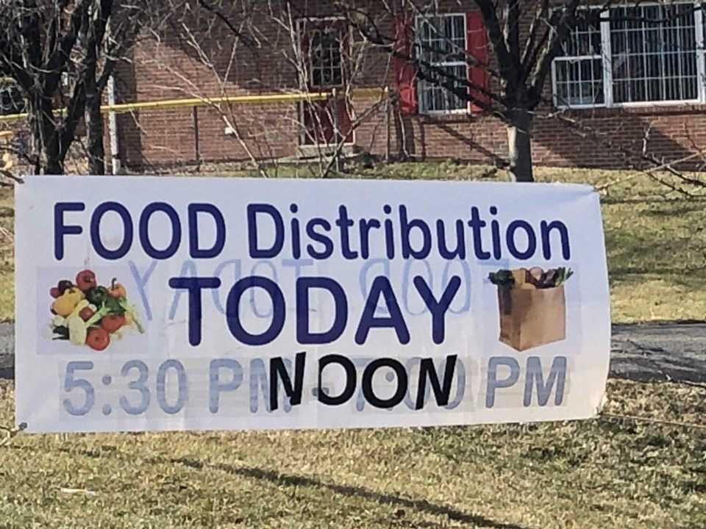
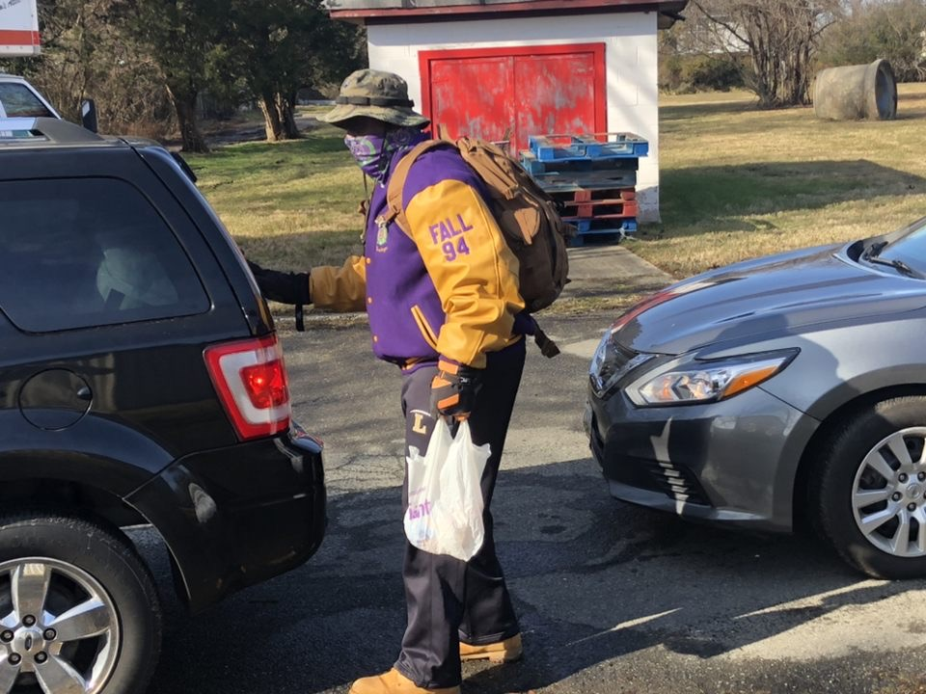
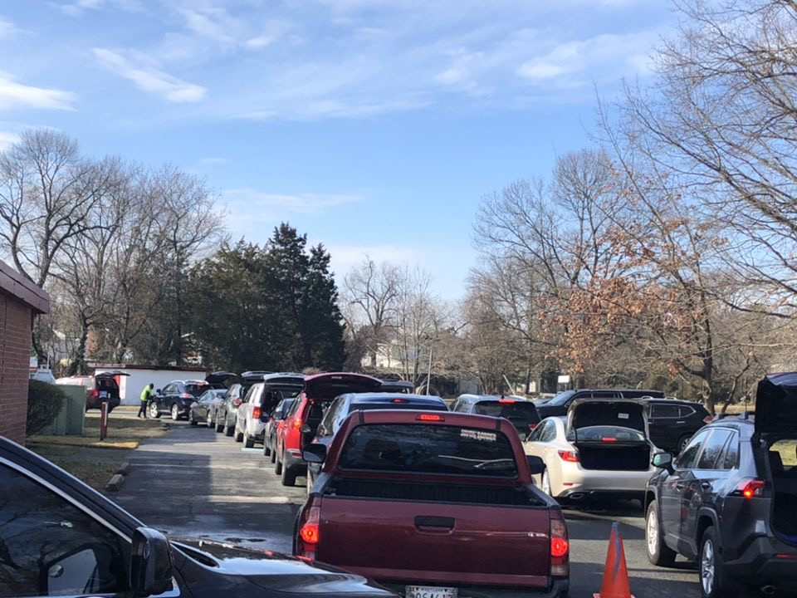
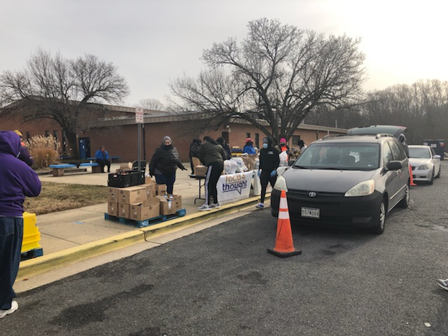
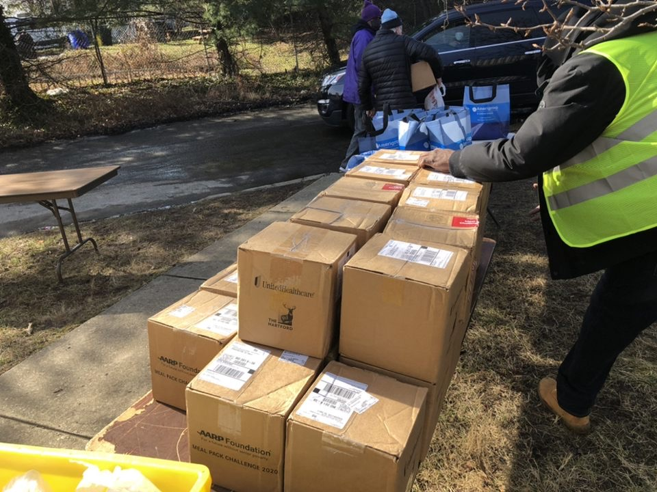
Chapter of the month gamma pi chapter (4/5)
January 30, 2021 - Grab and Go St. Paul Church in District Heights, MD
January 30, 2021 - Health Initiatives Charles R. Drew Memorial Blood Drive at Melwood.

Slide 15
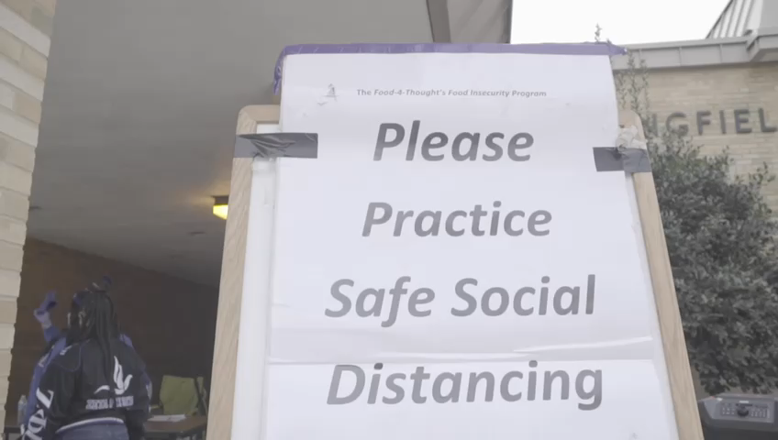
Chapter of the month gamma pi chapter (5/5)
Gamma Pi Essential Services Distribution Video

Slide 16
Alpha Delta Gamma Chapter highlights (1/1)
November 15- Executed coat drive/donation and community service project with Eastside Family Shelter in Baltimore in support of Intl Achievement Week.
November 16- Executed Goodie Bag Handout at McDaniel College
November 17- Held Founders Day Celebration at McDaniel College
November 18- Executed Mental Health Awareness Movie Night at McDaniel College
November 19- Executed Fellowship and Brotherhood Game Night at McDaniel College
End of Fall Semester for UG
December 5 & 12- Mandatory MSP Training
December 5- Highway Cleanup
January 4- Winter Session Classes Begin (All Virtual)
January 21- Winter Session Classes End
January 29- UG Students return to Campus for Spring Semester
February 1- Spring Semester Classes Begin
February 1- Met with Amanda Gelber to begin planning Spring events

Slide 17
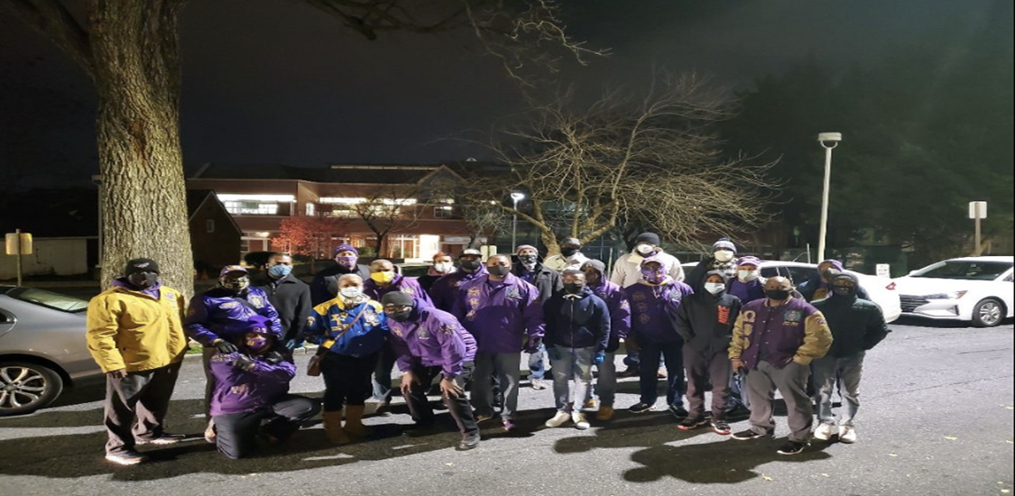
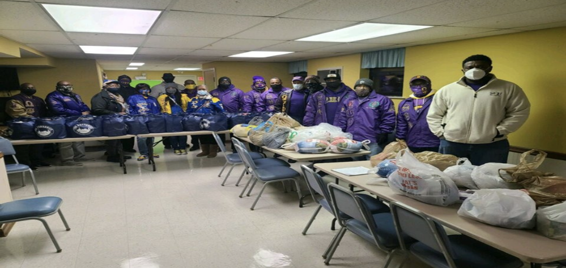
Alpha lambda lambda chapter highlights (1/1)
Lincoln Housing Community Ham and Turkey donations on 11/23/2020
Lincoln Housing Community Christmas Ham and Turkey donations on 12/21/2020
Lincoln Housing Community Winter Coat donations to 18 residents
Six-week Ballroom dancing via zoom
High School Scholarship contest
April zoom party

Slide 18
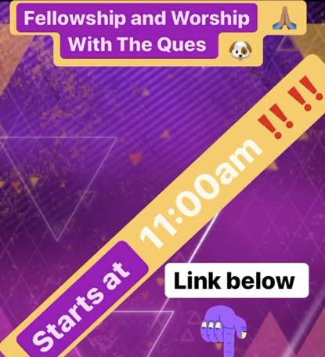
Epsilon sigma chapter highlights (1/6)
Sunday Service W/ The Ques
Sunday, November 15th, 2020
The Brothers of the Epsilon Sigma chapter gathered together to host a virtual church service. Brother Daniel Harris was the host for the event as he partnered with his church for the student body to enjoy. There were a total of 30 participants within the zoom call, brothers that were in attendance were Bro. Daniel Harris, Bro. J’Sean Williams, Bro. Marvin Flythe,
Bro. James Jones II, Bro. Larry Moore, Bro. Quentin Braswell, Bro. Abdur Saaba, and Bro. Rj Rountree.
“When They See Us”
Monday, November 16th, 2020
The Brothers of the Epsilon Sigma chapter hosted a Social justice panel where we allowed students, and faculty to discuss their opinions on Police brutality. The discussion Panel showed videos of previous police brutality and fatality and discussed possible scenarios where the individual’s life could have been saved.

Slide 19
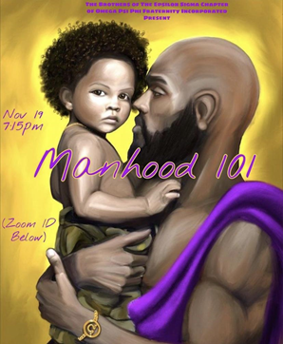
Epsilon sigma chapter highlights (2/6)
Manhood 101
Wednesday, November 18th, 2020
The Brothers of the Epsilon Sigma chapter presented Manhood 101 to the young brothers of Bowie State University. The event focused on the social interactions of Black Men amongst each other and how we can better influence our community. Women were also allowed to participate to add a different perspective to what it is to be a man. We had a total of 25 participants on Zoom, in addition to brothers Bro. Marvin Flythe, Bro. James Jones II, Bro. Jordan Carter, Bro. Daniel Harris, Bro. J’Sean Williams, Bro. RJ Rountree. Speakers of the group focused on the definition of a man, roles, responsibilities, and the taboo subjects of what a man is not.

Slide 20
Epsilon sigma chapter highlights (3/6)
Women's Appreciation
Friday, November 20th, 2020
The Brothers of the Epsilon Sigma chapter supported the women of Bowie State University and gave appreciative words to them. Members of the Epsilon Sigma chapter each read off an inspiring quote to the women who participated in the discussion. We also introduced a panel discussion where members asked women questions about what they would like to see men do for them. In addition to understanding what habits that men carry that they would like to see more of or less. The brothers that participated are Bro. Marvin Flythe, Bro. James Jones II, Bro. Jordan Carter, Bro. Daniel Harris, Bro. J’Sean Williams, Bro. RJ Rountree.

Slide 21

Epsilon sigma chapter highlights (4/6)
Hand Sanitizer Give Away
Bowie, MD
Wednesday, January 27, 2020
The Brothers of the Epsilon Sigma Chapter of the Omega Psi Phi Fraternity, Incorporated received a donation of 2,160 hand-sanitizers bottles which was a total of 180 cases. The Brothers that participated in the distribution of hand sanitizers were Brother J’sean Williams, Jordan Carter, Daniel Harris, RJ Rountree, James Jones II, and Brother Barry Amos of the Omicron Psi Chapter who is attending undergraduate school at Bowie State University.

Slide 22
Epsilon sigma chapter highlights (5/6)
The brothers met, socially distanced on Bowie State University’s campus, and were successful in handing out over half of the donated bottles, throughout the campus. Brothers hosted a table from 3 pm-5pm, playing music to gain students' attention and talked about the awareness of social distancing and properly washing their hands to combat COVID 19. Through these conversations over 750 individual hand sanitizers were distributed. As an additional step to increase health awareness, the Brothers delivered several cases to faculty offices, student dormitories, as well as facilities that are used independently by students, such as the University weight room. With close to 1000 bottles left to distribute, the Chapter thought it would be best to continue the mission of servitude, as a result, they donated 864 to the graduate advisory Chapter, Gamma Pi who planned to distribute throughout their immediate community of Prince George’s County. With ovid cases in Maryland rising over 350,000 with a current death total of 7,188 it is important for all to do their part in stopping the spread. Our founding father and brothers have always done everything in their power towards the betterment of the world we live in. The Brothers of the Epsilon Sigma Chapter aim to continue to carry on with tradition in accomplishing these honorable missions.

Slide 23

Epsilon sigma chapter highlights (6/6)
Que Baby Supply Drive
Bowie, MD
Monday, February 1, 2020
The Brothers of the Epsilon Sigma Chapter have taken the first day of Black History Month, first initiated by Brother Carter G, Woodson, to show appreciation to our women. Brothers began to collect baby supplies for new mothers at Bowie State University and within the community alike. Within three days, Brothers were able to collect 225 diapers, 8 baby bottles, 12 onesies for both girls and boys, baby towels, and over 1500 wipes. The Brothers also began a Go Fund Me with a goal total of $1000, already raising $55 of that $1000. As the month of february continues Brothers plan on surpassing our set goals and continuing to protect womanhood by assisting them in any way.

Slide 24
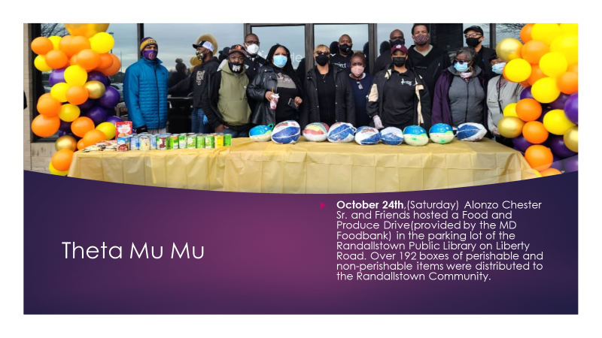
Theta Mu Mu chapter highlights (1/3)

Slide 25
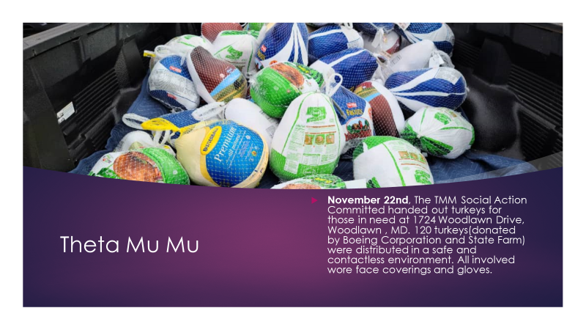
Theta Mu Mu chapter highlights (2/3)

Slide 26
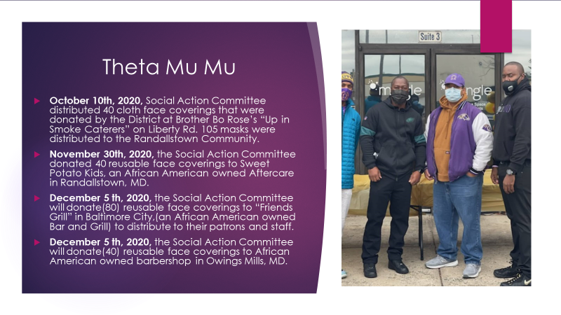
Theta Mu Mu chapter highlights (3/3)

Slide 27
Iota mu mu Chapter highlights (1/3)
Participated in virtual Achievement Week Programs
Participated in IHQ’s virtual Founders’ Day Event
Hosted virtual Reclamation event during Army vs Navy Football Game Weekend
Donated food and clothing for the homeless over the holidays
Adopted a family of 4 for the holidays
Major Andrew Holmes, USMC, 4-05-Mu Rho, Naval Academy Ques was guest speaker for Sigma Gamma Gamma Chapter of the Omega Psi Phi Fraternity, Inc. (Okinawa, Japan) MLK event
First Vice Grand Basileus, Bro Ricky Lewis installed IMM Chapter Officers at Swearing in Ceremony
Participated in several Get out to Vote events

Slide 28
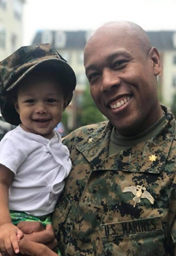
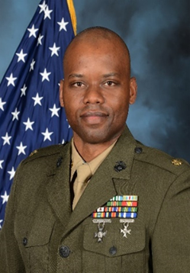
Iota mu mu Chapter highlights (2/3)
Bro Cedric Jefferson, 8-05 Mu Rho and Bro Reginald Sealey, 12-05-Mu Rho, both Naval Academy Graduates were promoted to the rank of Lieutenant Colonel, United States Marine Corps
Major Cedric Jefferson, USMC
Major Reginald Sealey, II, USMC

Slide 29
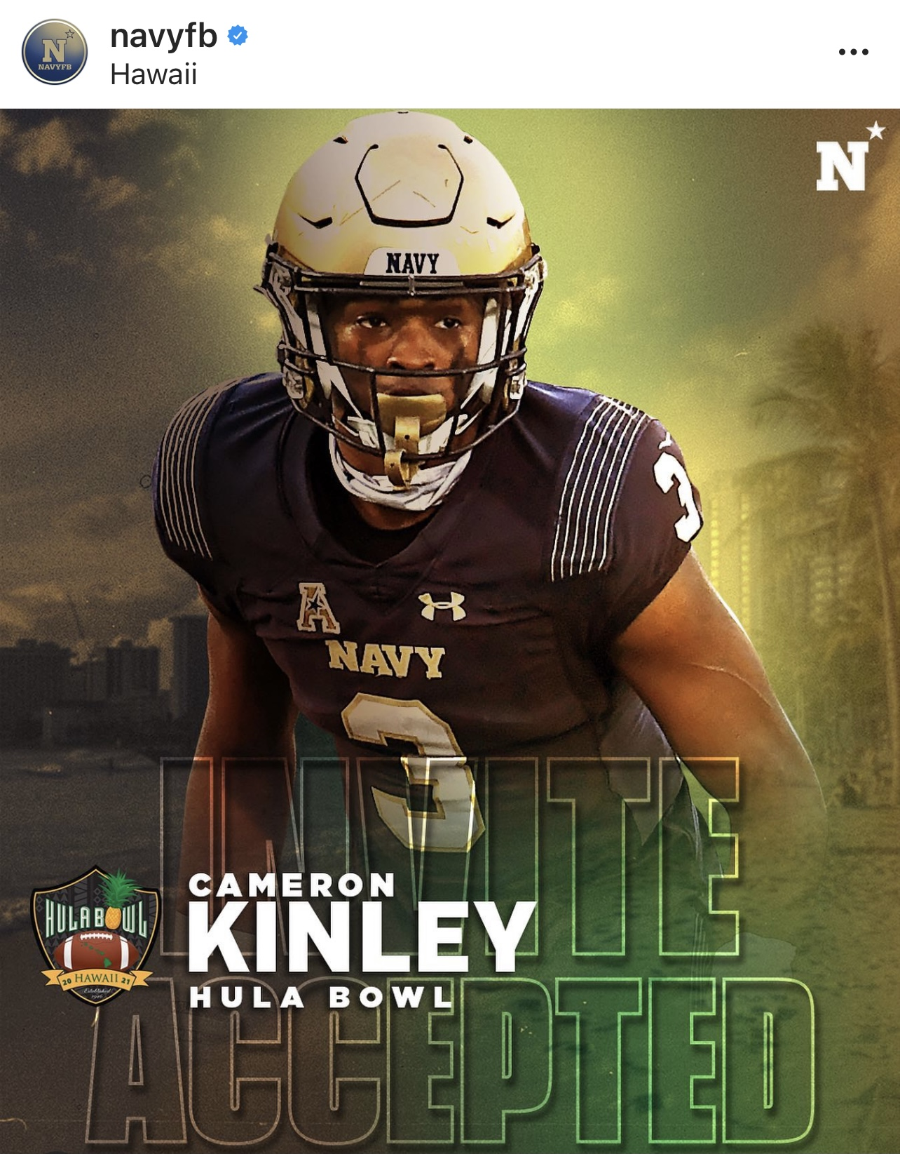
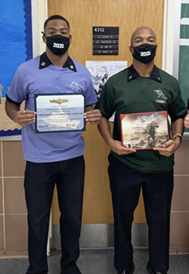
Iota mu mu Chapter highlights (3/3)
Bro Jonathan Lee (3-20-IMM) was selected as Regimental Commander, the 2nd highest ranking position at the US Naval Academy and is serving along with the 1st Black Female, Brigade Commander, the highest-ranking position at USNA. Living Black History!
Bro Cameron Kinley (2-19-IMM) was selected to participate in The All-Star Hula Bowl Classic, college football game in Honolulu, Hawaii. This game recognizes some of the top collegiate football players in the country and internationally; in many cases these players go on to play in the NFL.
Cameron Kinley and Jonathon Lee (Regimental Commander)
Cameron Kinley

Slide 30
Iota nu Chapter highlights (1/3)
November: Iota Nu seated the slate of elected officers in November. Brothers assumed the following offices: Brother Aurelio Burton, Basileus; Brother Anthony Dorsey, Vice-Basileus; Brother Azagio Herd (Alpha Delta Gamma Undergraduate Chapter), 2nd Vice-Basileus; Brother Edwin Kolen, Keeper of Records and Seal; Brother Brian Wilson, Keeper of Finance; Brother Michael Bennett, Chaplain; Brother Michael Grim, Chapter Reporter; Brother Dwayne Adams, Parliamentarian; Brother Jon Story, Keeper of Peace; and Brother Charles Gibson assuming the role of Immediate Past Basileus.
Iota Nu and Alpha Delta Gamma Chapters hosted a Virtual Achievement Week Awards Celebration on November 16, 2020. This celebration honored Omega men and individuals for their contributions in uplifting the Harford County community. Other activities included attending church service, a Virtual Founder Day Celebration, membership and PPE donation to Boys and Girls Club and a laptop donation to the Edgewood Elementary School.

Slide 31
Iota nu Chapter highlights (2/3)
Iota Nu conducted its first highway clean-up project of the Fraternal Year in December by removing trash from stretches of roadsides in Aberdeen, MD. Brother Eric Story, Iota Nu’s Highway Cleanup chairperson lead the effort and organized the chapter to fulfill fulfill the chapter’s “Adopt-a-Highway” commitment. The highway cleanup up activity provides an opportunity for camaraderie for chapter members and a golden opportunity for service to the community.
Brother Michael Bennett coordinated Iota Nu’s participation in adopting five (5) families from the Harford House of Aberdeen during the Christmas Holidays. The members from each family provided a holiday wish list of items, and Iota Nu came through with all items the families requested and more. Additionally, Brother Bennett coordinated Iota Nu’s support of the Aberdeen Middle School “Holiday Healthy Heart Food Give-Away”. The event provided students and their families with food, board games, coats, cooking accessories, clothing many more holiday giveaways.

Slide 32
Iota nu Chapter highlights (3/3)
Brother Anthony Dorsey, Brother Michael Bennett and Brother Satchell Doyle Jr fulfilled Iota Nu’s pledge to donate twenty boxes of pre-packaged perishable food items to the Fairbrooke Senior Assisted Living Complex during the holiday season.
Iota will be celebrating its 51st Anniversary on 28 January 2021. The initial steps in establishing an Omega Psi Phi chapter in Harford County began in January of 1969. Seventeen charter members met regularly to encourage more fellowship amongst Omega men in the area, foster a sense of urgency to actively engage the youth in the area and to lay groundwork for the establishment of Iota Nu. Subsequently, Iota Nu’s application was approved and on the glorious day of January 28, 1970, Iota Nu became an official chapter of the Omega Psi Phi Fraternity, Inc. Brother Anthony Dorsey serving as Chairman and Brother Terrel Lowery serving as Co-Chairman are coordinating a virtual Anniversary celebration via Zoom. The event will consist of formal presentation, followed by a benediction and fellowship.

Slide 33
Lambda gamma gamma Chapter highlights (1/2)
November 7 – 14: Virtual 5K Run/Walk
November 7: Achievement Week Virtual Awards' Program and Officer Installation
November 8: Virtual Church Service w/ Gethsemane AME Church, LGG donated $1,000 to the church for its youth-based activities
November 12: Chapter Virtual Reclamation Night
November 14: Awarded $1,700 to winners during the National Essay contest
November 14: Achievement Week Virtual Founders Program moderated by Bro. Harry Lennis. Panelist: Honorable Mayor Bro. Tim Adams, Honorable Judge Bro. John Younge, Dr. Jessie K. Marshall, Dr. Tyrone Powers and Honorable Mayor Muriel Bowser

Slide 34
Lambda gamma gamma Chapter highlights (2/2)
November 21: Project Uplift – We participated in the Union Temple Baptist Church's Thanksgiving dinner drive
November 23: Project Uplift - Thanksgiving where we picked-up and passed out 100 turkey dinners from the Sharefood Network and passed-out to Suitland Manor, Fort Meade and in Northern Virginia families.
December 12: Virtual 2020/21 Strategy Session and Seminar Overview (SSSO) & Chapter Meeting
December 15: Project Uplift - Christmas where we collected donated toys and delivered the gifts to DMV families
December 28: Virtual Chapter 36th Anniversary Fellowship
January 16: LGG Chapter Meeting
January 29: Winter Coat Drive contactless drop-off. Coats will be donated to homeless shelters in Washington, DC.

Slide 35
Mu Nu Chapter highlights (1/2)
November 10; Mu Nu's Achievement Week Virtual Awards' Program
December 2020; Held Chapter Dashiki Photo Op at Howard University
December 23, 2020; Shepherd's table monthly "Food Service" project involves brothers donating their time once a month to prepare/distribute food to homeless people in Silver Spring, MD.
November – December, Bridge Builder Mentor Program: Bi-weekly sessions are held each month, on Saturday morning, where students from across Montgomery County, Maryland participate in mentoring lessons geared toward promoting positive social-emotional development for middle school students.
December 23; Toys for Tots & Teens: This annual project involves brothers of Mu Nu Chapter and the community participating in a Toy Drive to support families of the Housing Opportunities Commission of Olney, MD. Families who participate in the Section 8 Housing Program are provided with toys for the holiday season.

Slide 36
Mu Nu Chapter highlights (2/2)
January 18, 2020; M.L.K. Day of Service - There were two service projects: Project #1 involved collecting toiletry items and putting together transitional baskets for the homeless men of Montgomery County, MD who reside at the Montgomery County Coalition for the Homeless located in Rockville, MD. Project #2 involved collecting food items to support Shepherd's Table meal service program.
Feb 20th – Virtual HBCU College Fair (MD)
Feb 27th – Annual District Game Changers Youth Mentoring Conference

Slide 37
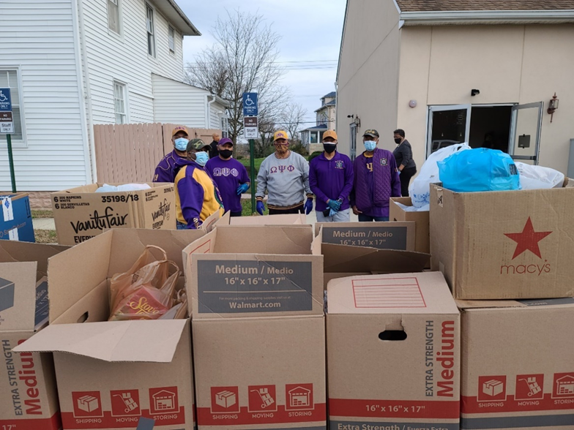
Mu Rho Chapter highlights (1/10)
The Mu Rho Community News – Lifting as We Climb
The Mu Rho Chapter of Omega Psi Phi, Incorporated has sponsored and participated in several community service events in the past year. Consistent with the Fraternity’s cardinals of Manhood, Scholarship, Perseverance and Uplift, the Chapter has successfully organized the resources to uplift communities where we live, work, and serve.
On November 21, 2020, members of the Mu Rho Chapter of Omega Psi Phi, Inc. donated meals to help feed more than 40 families in the Parole Community of Annapolis, Maryland. Chapter members were onsite to assemble, pack and to assist in loading meals into vehicles where many recipients were elderly. In addition, the chapter assisted with distributing school supplies to families with school-aged children. The event was hosted by Mt. Olive A.M.E Church, who has been a pillar in the community for over 150 years.

Slide 38
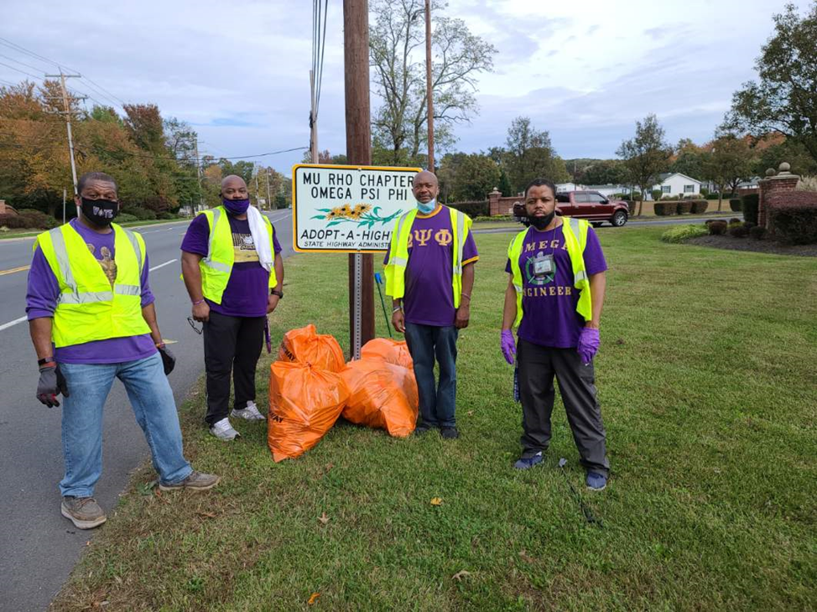
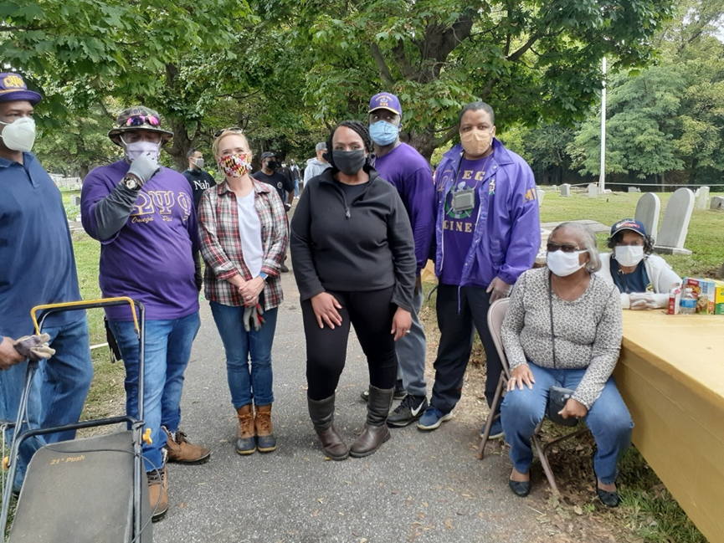
Mu Rho Chapter highlights (2/10)
Adopt-A-Highway Clean Up
On September 24, 2020, members of the Mu Rho Chapter of Omega Psi Phi, Inc. performed a community cleanup project by cleaning a stretch of highway in Anne Arundel County through the Maryland Department of Highway’s Adopt-A-Highway program. This is just one of the chapter’s ongoing community service projects.
Brewer Hill Cemetery Clean Up
On October 10, 2020, the Mu Rho Chapter Omega Psi Phi, Inc. partnered with Maryland State Delegate Shaneka Henson of Annapolis, MD in an all-day community cleanup and beautification project at Brewer Hill Cemetery for the more than a century old African American burial ground. History: https://historybrewerhill.wixsite.com/1884

Slide 39
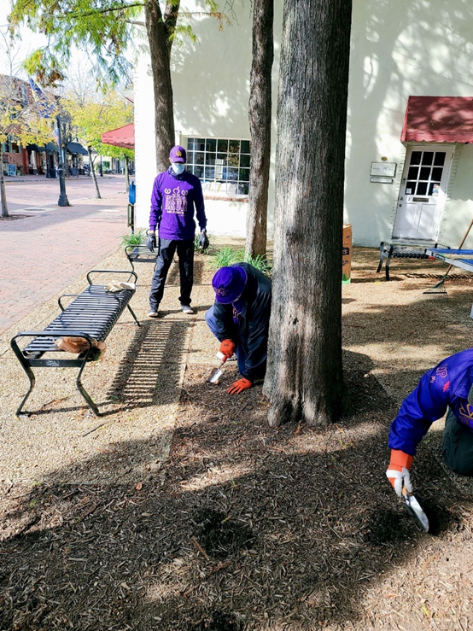
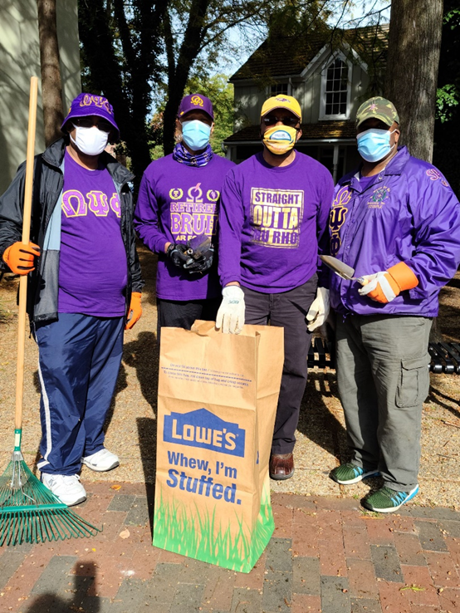
Mu Rho Chapter highlights (3/10)
Weisman Park Tulip Planting
On October 29, 2020, the Mu Rho Chapter of Omega Psi Phi, Incorporated planted 24 purple tulip bulbs at Weiseman Park in Annapolis, Maryland. The project was a part of a city-wide beautification project known as GreenScape 2020 sponsored by the Parks and Recreations Department for the City of Annapolis.

Slide 40
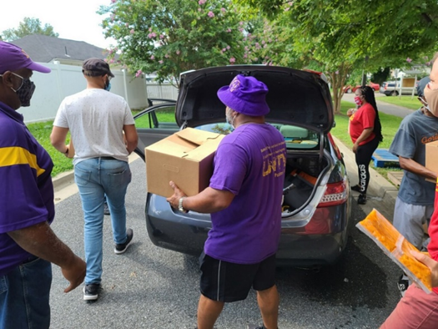
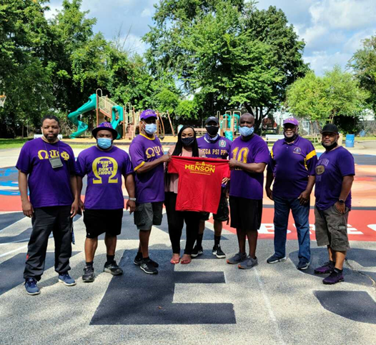
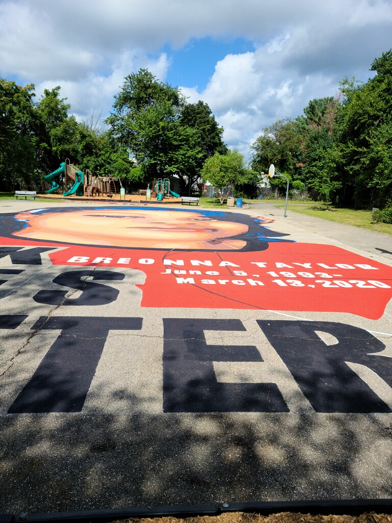
Mu Rho Chapter highlights (4/10)
Food Drive for COVID-19 and Community Activism
On August 22, 2020, the Mu Rho Chapter of Omega Psi Phi, Incorporated participated in a food drive sponsored by the Parole Community Association and by Maryland State Delegate, Shaneka Henson of Annapolis, MD. Members assisted with unloading truckloads of food, packaged food for pick-up and placed them into vehicles to help feed more than 40 families impacted by the Covid-19 pandemic.

Slide 41
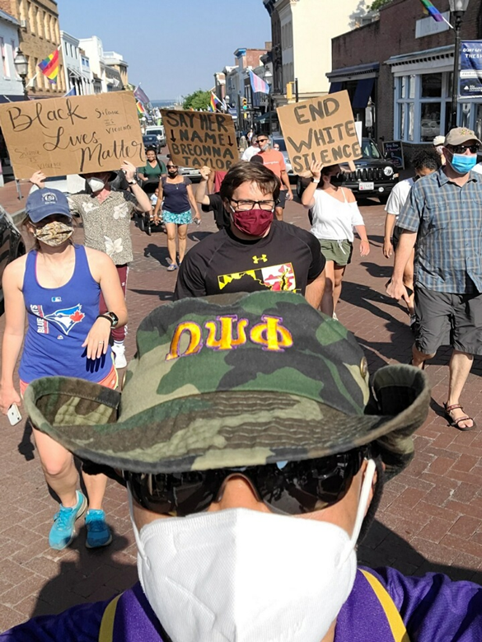
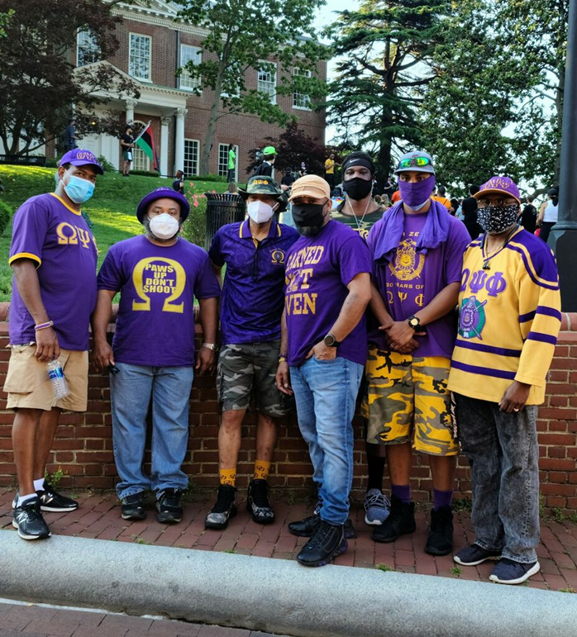
Mu Rho Chapter highlights (5/10)
Black Lives Matter State Capitol Protest
On June 10, 2020, the Mu Rho Chapter of Omega Psi Phi, Inc. participated in a peaceful protest at the state capitol in Annapolis, MD to denounce racism and police violence.

Slide 42
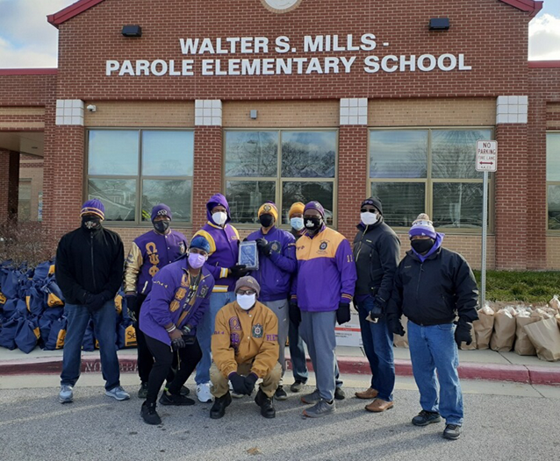
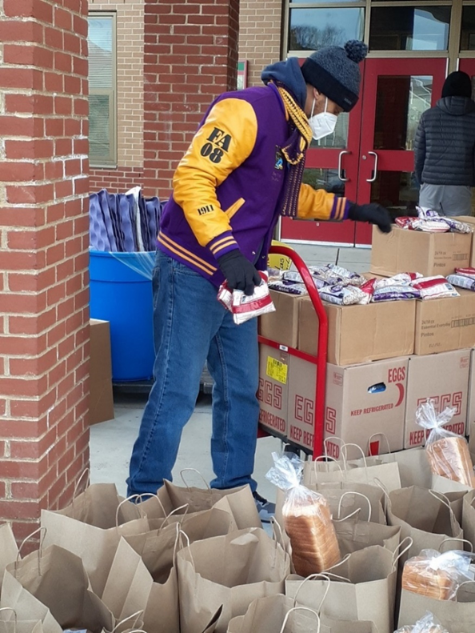
Mu Rho Chapter highlights (6/10)
Food Pantry
In January 2021, Mu Rho Chapter of Omega Psi Phi Fraternity, Incorporated teamed up with the community of Annapolis, MD to provide 600 meals to local families. Members of Mu Rho also provided more than 50 meals to the Lighthouse Homeless Shelter in Annapolis.

Slide 43
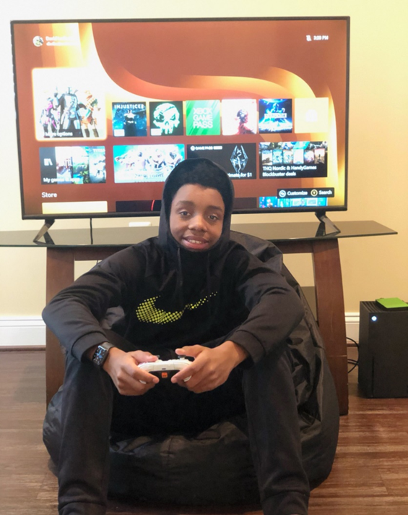
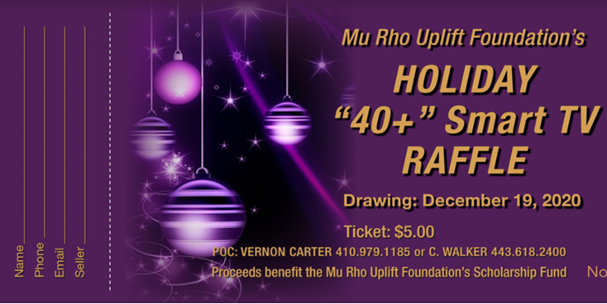
Mu Rho Chapter highlights (7/10)
Holiday Raffle
On December 12, 2020, Mu Rho Chapter’s raffle ticket fundraiser culminated with the presentation of the grand prize (50’ Smart TV) to a family in Baltimore, MD. The successful event raised additional funds for the chapter’s Scholarship Fund.

Slide 44
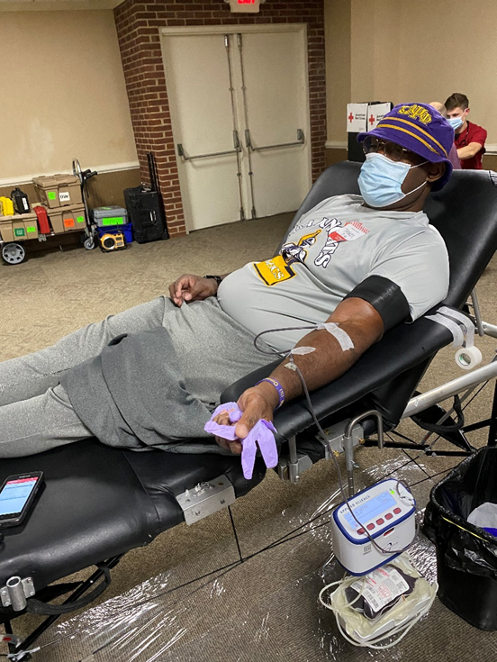
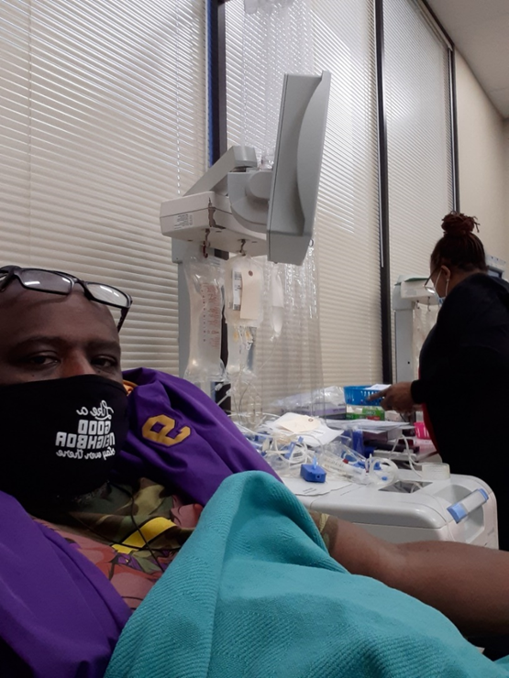
Mu Rho Chapter highlights (8/10)
Dr. Charles R. Drew Blood Drive
On January 19, 2021, Mu Rho participated in the Dr. Charles R. Drew Blood Drive, organized by Omega Psi Phi Fraternity, Incorporated in partnership with the American Red Cross.

Slide 45
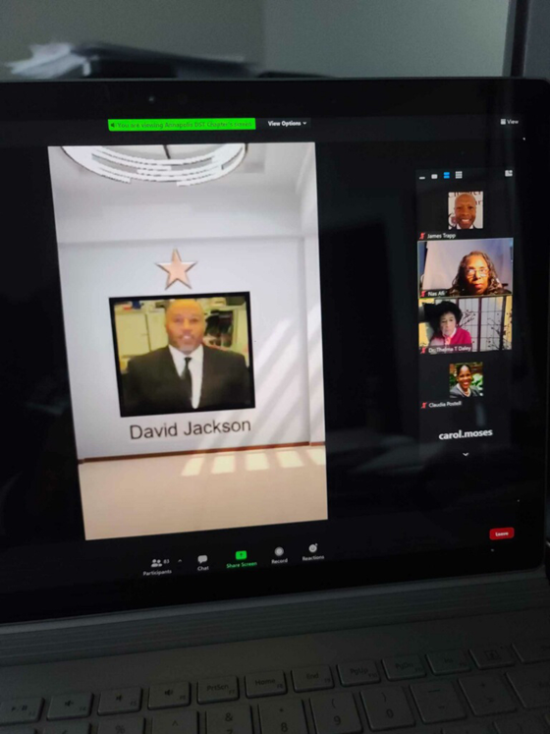
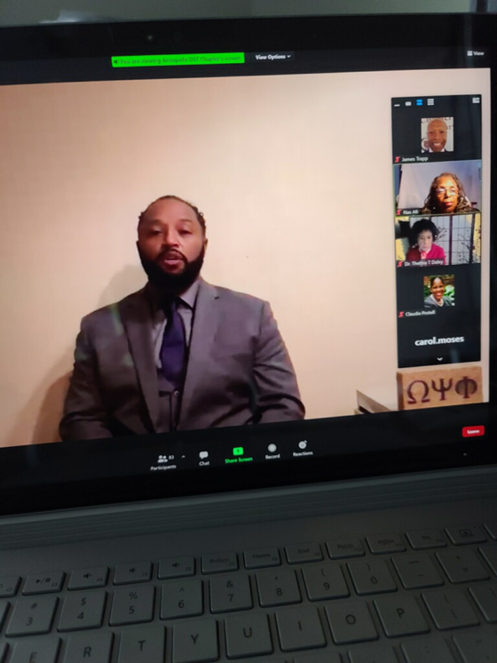
Mu Rho Chapter highlights (9/10)
Community Service Award
Mu Rho’s community service efforts have not gone unnoticed. On January 31, 2021, the Annapolis Alumni Chapter of Delta Sigma Theta honored Mu Rho Chapter, represented by David Jackson, with a community service award for the work and uplift provided to the Anne Arundel County.

Slide 46
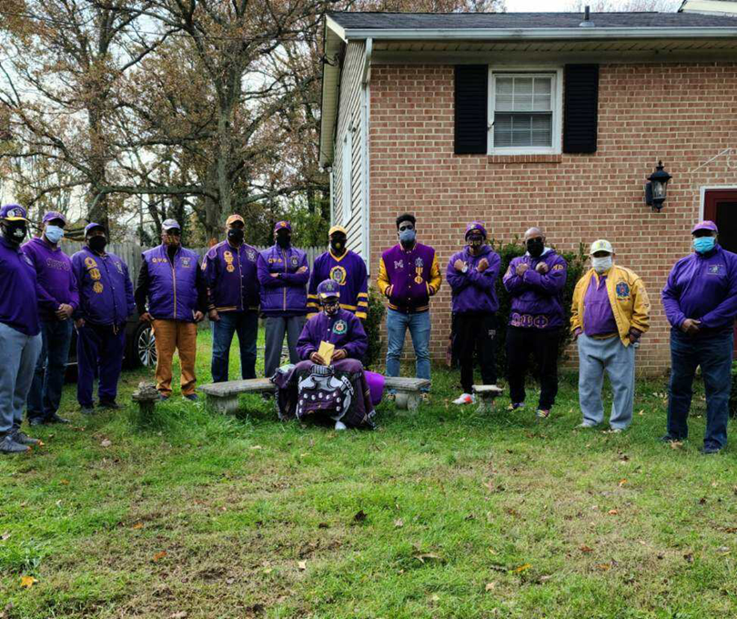
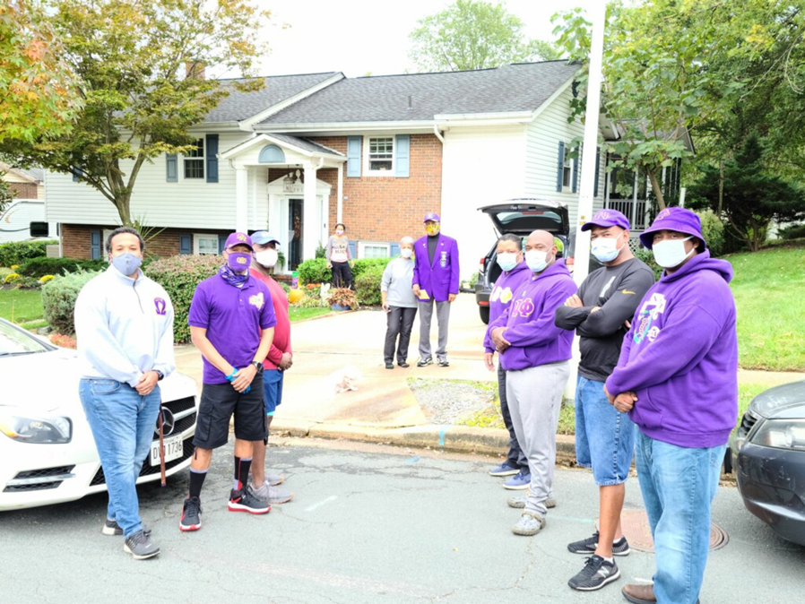
Mu Rho Chapter highlights (10/10)
40 Years of Service
Mu Rho Members pay a visit to Brother Charles Simms, who celebrates the milestone of 40 years in the Fraternity.
Our Brother’s Keeper
The brothers of Mu Rho Chapter visited Brother Henry “Hank” Bellinger in support of his recovery from an illness.

Slide 47
Pi omega Chapter highlights (1/3)
November 2020
Hosted Feeding Across the District
Completed donation of 22000 masks to organizations throughout Baltimore City
Donated 65 Turkeys to needy families
Donated 40 Thanksgiving Baskets - Terrance Gardens Senior Center
Donated Bleach and Household Supplies (Bleach, Soap, Toothpaste) to 8 Missions throughout Baltimore City
Donated 110 Thanksgiving Dinners to the Baltimore Community
Pi Omega 2020 Line - Donated and delivered 30 Thanksgiving meals
December 2020
Afro Ms. Santa (Baltimore Afro-American paper) - Toy Donation
Donated 300 Toy bags to the following:
Christian Shelter
St. Gregory Church
Baltimore City Social Services

Slide 48
Pi omega Chapter highlights (2/3)
Donated 500 toothbrushes to the following: Laurel Advocacy & Referral Services, Daysprings Program, Dove Center, DC Diaper Bank, Asylee Women Enterprise (100 toothbrushes)
Assisted with Delta Sigma Theta Toy Drive and Gift-wrapping initiative
Assisted with Zeta Phi Beta Toy Drive
Matthew Henson Elementary Toy Drive
January 2021
Donated 500 pairs of socks to various Men’s and Women's Centers throughout the state of Maryland
Donated 500 toothbrushes to recovery centers and shelters throughout Maryland
Community food drive - Fresh Produce Giveaway
Donated 25 Blankets for the Homeless, and 30 pairs of Pajamas for Casey Cares Foundation(Kammie's Jammies)
Paper Towel and Soap donation to YWCA in Arnold, MD, Night of Peace Family Center and Household Supplies to Agape House

Slide 49
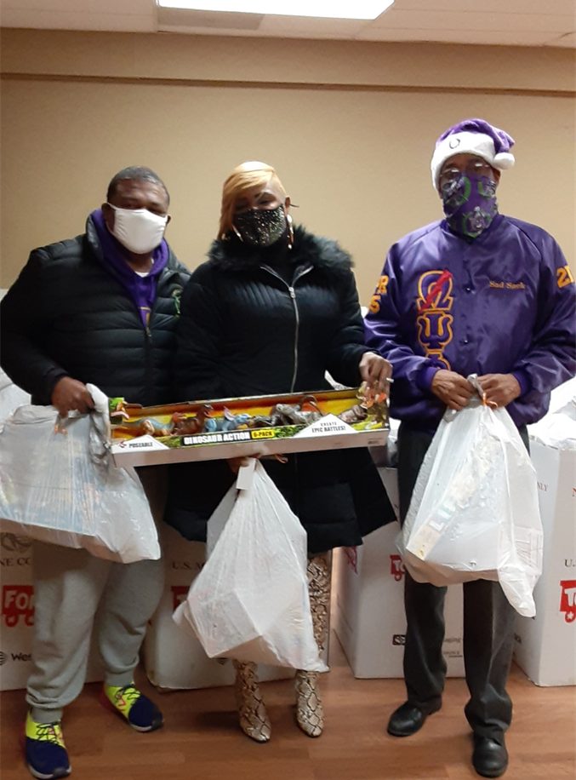
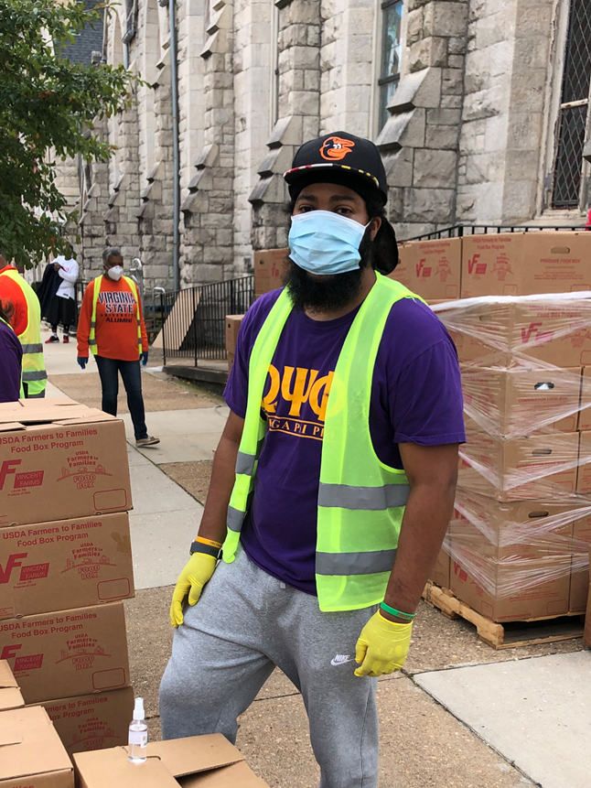
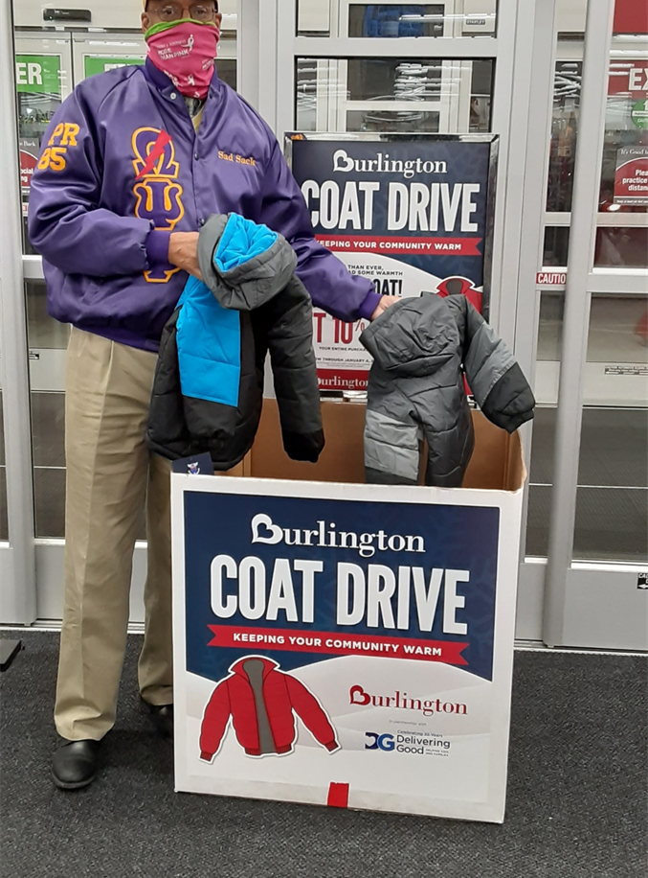
Pi omega Chapter highlights (3/3)
Pi Omega served the Baltimore City Community through Burlington Coat Factory’s Coat Drive
Pi Omega serves community through Toys for Tots Initiative
Pi Omega Serves Produce for the Baltimore City Community

Slide 50
Tau Pi Chapter highlights (1/1)
Volunteered and served in conjunction with St John Baptist Church at the Cedar Lane food Pantry
Donated 30 Thanksgiving Food Baskets along with $20 gift Cards to Needy families in Howard County
Donated 22 desk and chairs to students at Guilford and Jeffers Hill elementary schools
Held 2 virtual public forums for Candidates for Circuit Court Judge of Howard County and Board of Education for Howard County
Donated 1500 pounds of food to the MD Food Bank on the MLK Day of Service.

Slide 51
Chi Delta Chapter highlights (1/2)
Completed Activities
Chi Delta Inaugural Achievement Week Program
Roughly 78 people in attendance virtually including Bro. Immediate Past DR Kendall J. Smalls (Keynote Speaker), Bro. DR Kelvin Ampofo, Bro DKRS Amir Shareef, and Bro. Past 1st Vice Grand/16th DR Adam Mckee Jr.
Other Honored Guest - President Darryll J. Pines (University of Maryland College Park) & State's Attorney Aisha N. Braveboy (Prince George's County). President Pines received Educator of Year Award and SA Braveboy received Citizen of Year Award
Omega Man of the Year - Joseph Drayton 2 XD '91

Slide 52
Chi Delta Chapter highlights (2/2)
Currently Executing
Chi Delta Coat Drive
Initiative in partnership with Prince George's House Men's Shelter
Chi Delta Leadership program
The program focuses on providing life long skills to the Greater College Park community and university students that can translate to multiple walks of life. The program will also be in partnership with the University of Maryland's Nyumburu Cultural Center to better target the African American community.
Chi Delta chapter endowment at the University of Maryland
The chapter is moving toward providing scholarships to University of Maryland students through an endowment
Chapter in communication with legislators on our stance on specific legislation that will affect the Prince George's County/Greater College Park area

Slide 53
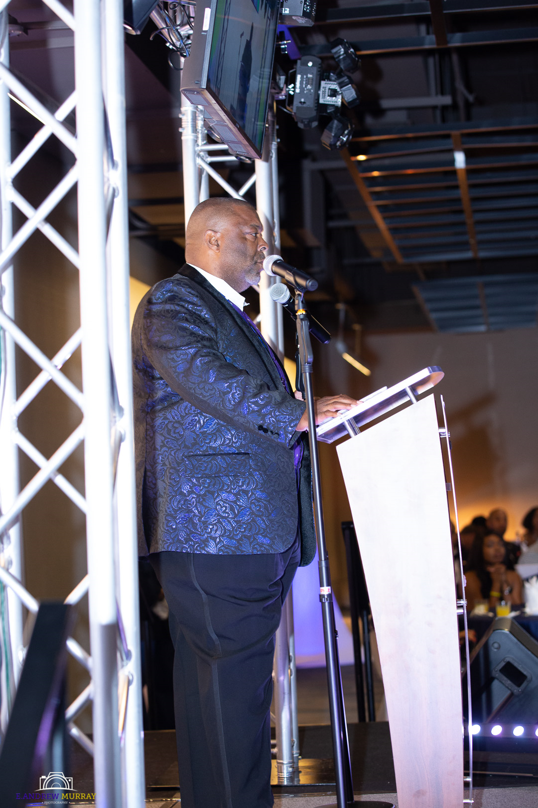
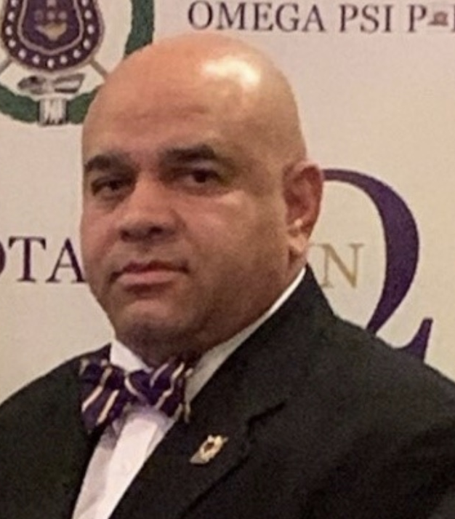
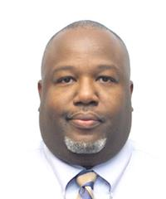
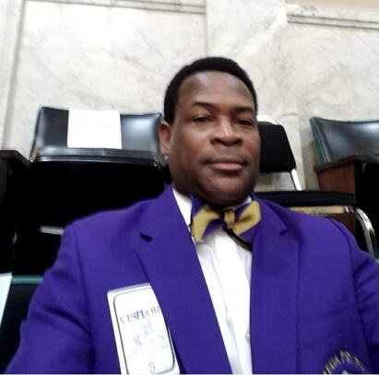
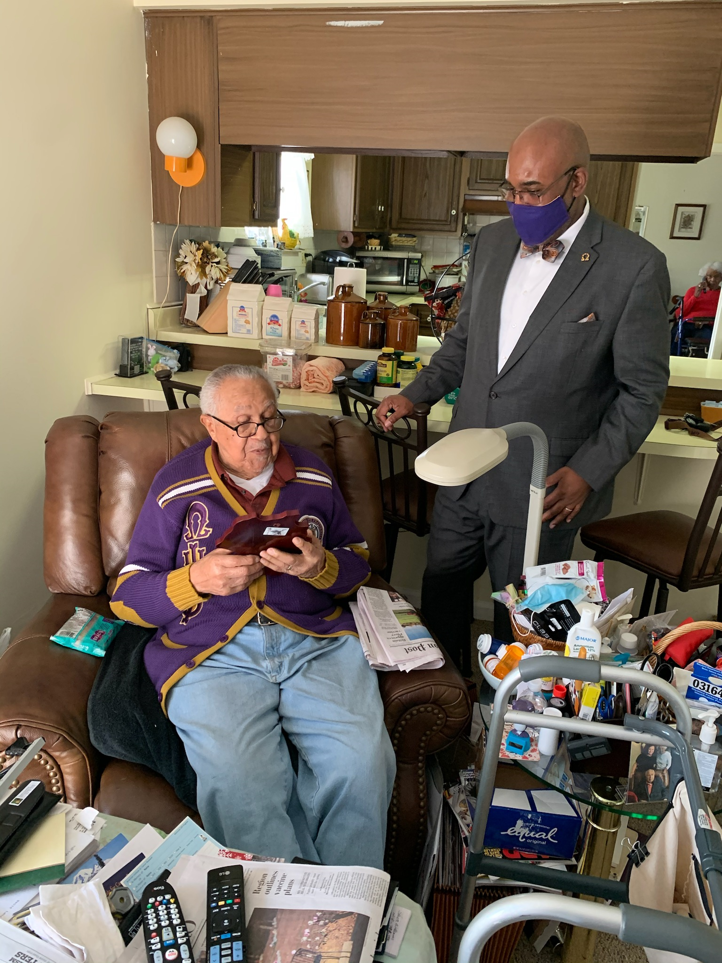
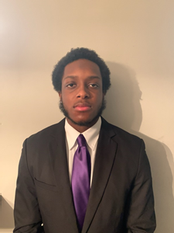
Corridor I chapters Omega Men of the year
Bro. Daron Fullwood
Iota Mu Mu Chapter
Bro. Charles Gibson
Iota Nu Chapter
Bro. Antonio Ferguson
Lambda Gamma Gamma Chapter
Bro. Cornell Walker
Mu Rho Chapter
Bro. Gerald Greenfield
Tau Pi Chapter
Bro. J’Sean Williams
Epsilon Sigma Chapter
Bro. Aris Mayfield
Alpha Delta Gamma Chapter
Bro. Larnell Simpson
Alpha Lambda Lambda Chapter
Bro. Eric Fields
Gamma Pi Chapter
Bro. Robert Hogan
Delta Beta Chapter

Slide 54
Corridor I chapters Omega Men of the year
Bro. Eric Ravenell
Theta Mu Mu Chapter
Bro. Walter Neighbors
Mu Nu Chapter
Bro. Lamonte Tyler
Pi Omega Chapter
Bro. Joseph Drayton
Chi Delta Chapter
Bro. Dr. Bernard Jackson
Co-Omega Man of the Year
Tau Lambda Lambda Chapter
Bro. William Hall
Co-Omega Man of the Year
Tau Lambda Lambda Chapter

Slide 55
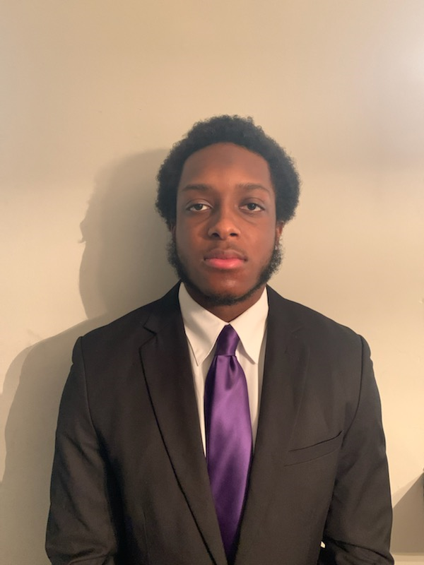
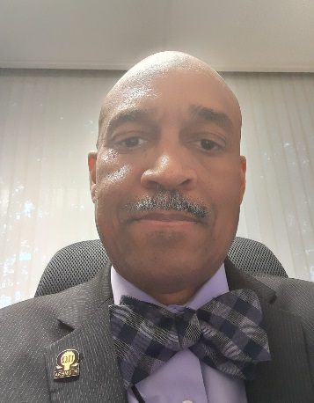
Corridor I brothers of the month (1/2)
Undergraduate Brother of the Month: Brother J’Sean Williams
Current Basileus, Epsilon Sigma Chapter
Leading reformation of administrative processes within his chapter
Outstanding efforts in also leading Epsilon Sigma to IHQ compliance
Graduate Brother of the Month: Brother Dwayne White
Current 2nd District Social Action Committee Chair
Currently Corridor 1 Social Action Committee Chair
Plans and leads many key community service and social action initiatives throughout the corridor

Slide 56
Corridor I recognition (2/2)
HONORABLE MENTION
Brother Jerry Watkins (Mu 1969): Brother Watkins currently serves as Co-Chair Of Tau Pi's mentoring program, Chairman of My Brothers Keeper( serves the needs of older brothers in the chapter particularly those over the age of 80), and Chapter Editor to the Omegan. Brother Watkins is also a key figure in making sure that Tau Pi's widows are not forgotten; he sends Holiday Cards to them and keeps them informed regarding chapter events.
Brother Michael Jackson (Mu Omicron 1970): We want to thank Brother Jackson for his undying love and commitment to Omega!! He leads by example and has influenced many brothers along his journey.
Brother William Haskett (Mu Rho 1981): Brother Haskett facilitates numerous food and toy drives. He is also the organizer of toy and food donations. Brother Haskett is a true leader and is instrumental to the success of Pi Omega Chapter’s Social Action Committee.

Slide 57
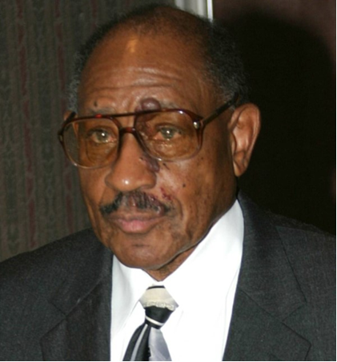
Corridor I 50 (plus) years of service (1/2)
LET US ALL CONGRATULATE BROTHER STANSBURY AND THE FOLLOWING LIST OF BROTHERS ON ACHIEVING 50 OR MORE YEARS OF SERVICE TO OUR BELOVED FRATERNITY. WE WOULD ALSO LIKE TO THANK EACH OF THEM FOR THE BRIDGES THEY BUILD AND THE TRAILS THEY BLAZE FOR THE REST OF US!!
Initiated in 1947
Pi Alpha Chapter
Charter Member of Pi Epsilon Chapter
Charter Member and Past Basileus of Iota Nu Chapter
Brother Russell Stansbury

Slide 58
Corridor I 50 (plus) years of service (2/2)
LET US ALL CONGRATULATE BROTHER STANSBURY AND THE FOLLOWING LIST OF BROTHERS ON ACHIEVING 50 OR MORE YEARS OF SERVICE TO OUR BELOVED FRATERNITY. WE WOULD ALSO LIKE TO THANK EACH OF THEM FOR THE BRIDGES THEY BUILD AND THE TRAILS THEY BLAZE FOR THE REST OF US!!
Brother Lester Buster initiated 1953
Brother Charles Alston initiated 1955
Brother Lonnie Liston Smith initiated 1958
Brother James Monroe initiated 1960
Brother Emil Cromwell initiated 1962

Slide 59
CORRIDOR I HONORED Brothers
AS LONG AS THOUGHTS OF A FRIEND LIVE IN THE HEART, TRUE FRIENDSHIP WILL NEVER PART…WE WOULD LIKE TO GIVE HONOR TO THE FOLLOWING FALLEN BROTHERS:
Brother Charles Elliot (Gamma Kappa Chapter, 1976)
Brother Daniel Harrison, Sr (Rho Chapter, 1986)
Brother Anthony “Tony” Lee (Beta Gamma Chapter, 1989)

